Slide 1
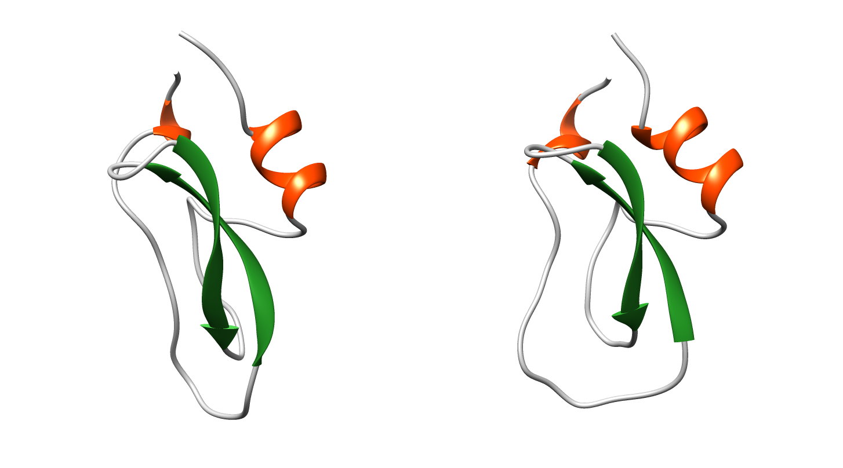
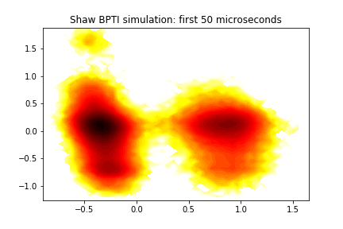
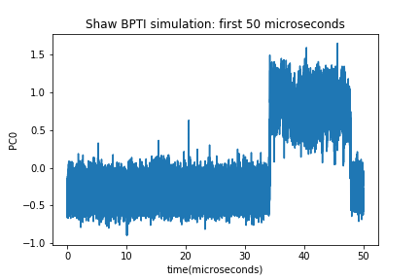
A CROSSFLOW Workflow to Study Protein Conformational Change
Using a CROSSFLOW workflow running on a CROSSBOW cluster, we study the BPTI conformational transition observed by Shaw et al. in their 1 millisecond (!) ANTON simulations.
B
PC2
A
B
A
PC1
B
In the ANTON simulation the first transition to state B was only seen after 35 microseconds of MD.
A
The CROSSFLOW workflow:
Starting structure
2
1
3
Run N independent MD simulations
A
4
B
Gradually a trajectory builds up, connecting conformations A and B
Calculate RMSDs of final structures from target (state B)
If any is closer than best yet, update starting structure
The workflow is running on an Amazon EC2 Cloud, using 12 GPUs

